Slide 1
Centralised Indicator Automation (CIA) Using RAP DHSC Coffee & Coding
Georgina Anderson
September 2021

Slide 2
Agenda
CIA Tool Overview
Project purpose and aims
Analytical Pipeline
Reproducible Analytical Pipeline – automated solution
Code maturity
Demo
Agile development
QA principles
Project backlog

Slide 3
Project purpose and aims
PHE calculates and publishes over 2000 public health indicators from various data sources
How the data flows:
Separate teams are responsible for generating groups of related indicators at a Profile level (respiratory, alcohol etc)
Data
Sources
Data Lake
Indicator Production
PHOLIO
&
Fingertips
Users

Slide 4
Project purpose and aims
See examples of the Profiles and Indicators being produced on the
PHE Fingertips Website

Slide 5


Project purpose and aims
Previously……
Individual scripts
eg
Get data
Calculate statistic
Disclosure control
Excel Spreadsheets
Notes:
Previously – semi-automated in that a script could produce an indicator
BUT….
No re-use of code between indicators/groups of indicators
Lack of central control of code - copies of scripts circulated between teams and edited – unintentional inconsistencies
Duplication of effort when anything needed changing
OR…..
Very manual copy/paste processing in Excel prone to error and inconsistency

Slide 6
Project purpose and aims
Reduce duplication of effort
Re-use of code - consistency
Bug fixes/ maintenance need to be done once only
Reduce resource requirements for indicator generation
Improve consistency of methods across indicators
IMRG approved methods
Version control
Previously semi-automated CIA Tool
eg
Get data
Calculate statistic
Disclosure control
Notes:
With CIA
Version controlled packages of related functions to perform each task
Pulled together into pipeline
Any changes just need to be made once in one place

Slide 7
Analytical Pipeline
Indicator Generation
Get numerator/ denominator counts from Data Lake
Indicator data
& supporting outputs
Apply disclosure control
Calculate statistics and confidence intervals
Apply disclosure control
Apply PHOLIO formatting
QA output

Slide 8
Reproducible Analytical Pipeline
CIA Tool Inputs
CIA Specifications
(numerator & denominator sources, methods, disclosure rules etc)
“instruction manual”
Indicatorautomation – “The CIA Tool”
DataLakeR
Gets numerator/ denominator counts from Data Lake
Indicator data
& supporting outputs
disclosurecontrolr
Applies disclosure control
PHEindicatormethods
Calculates statistics and confidence intervals
disclosurecontrolr
Applies disclosure control
Data Sources
(populations, births, deaths, HES etc)
pholior
Applies PHOLIO formatting
indiqar
Generates QA sense check output
Notes:
Centralised Indicator Automation
RAP = Reproducible Analytical Pipeline
LHS: Two Inputs to process – CIA Specifications (which data to use and what to do with it) and Data Sources
Middle:
indicatorautomation is the R package that brings whole process together – reads in data and definitions and spits out indicators
Calls modular R packages that manage each step in the indicator production pipeline
Grey box = “CIA Tool”. Data sources and definitions not controlled by CIA Team – QA of tool by developers excludes QA of ref tables (see later)
RHS: Outputs – indicator data in required formats plus QA and SQL supporting outputs

Slide 9
What is the CIA Tool?
The CIA Tool can generate indicator data in human readable and PHOLIO formats based on reference data supplied to it. The reference data is very detailed metadata that defines the indicator sources and methods, acting as an instruction manual for the CIA Tool.
Table of CIA Tool Instructions – which data to get and what to do with it
Indicator data
CIA Specifications
CIA Tool
Inputs
Outputs
Data Sources
Supporting outputs

Slide 10
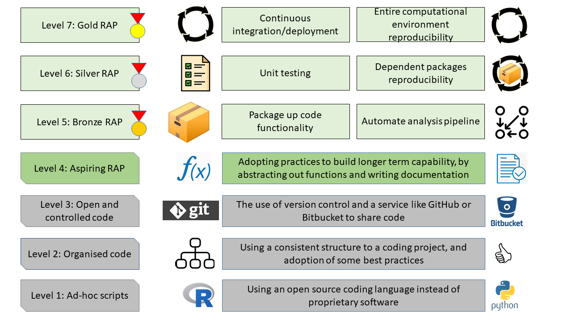
Code maturity
CIA
Source: Jamie Lendrum DSTL, GDS Slack
Notes:
One of PHE’s most maturely coded projects

Slide 11
Demo
Indicator 92309:
Proportion of the population aged under 18
Population of CIA Specifications
Run CIA Tool
Using R Studio console
Using R Shiny App (to be decommissioned)
Using Server-hosted web app (in development)

Slide 12
Which Indicators are Covered?
Agile Development of CIA Tool Scope
Sprints to add ‘features’ to scope of tool (eg new data sources or methods)
Features include:
Data sources (eg populations, births, mortality, hes apc ….)
Statistical Calculations (eg proportion, crude rate, DSR, life expectancy ….)
Breakdowns (eg geography, gender, IMD ….)
Methods (eg disclosure control, combining areas, aggregating
time periods, alcohol-attributable fractions ….)
Check the Feature Development Confluence page to see which features are in scope, in development or on the backlog
The CIA Tool can be used to generate an indicator once all
data sources and methods required are in scope
Notes:
If a feature is not in scope then it gets added to our backlog.
If a Data Source or breakdown group is not in scope but is stored in the Data Lake (eg in an Analysis Database) – a semi-automated solution exists whereby if users can write their own SQL to obtain their counts then this SQL script can be fed into the CIA Tool pipeline to pass those counts through the remainder of the CIA Pipeline – MHSDS using this.

Slide 13
QA Principles
Indicators go through 3 stages of QA:
QA Responsibility | Execution pattern | Purpose
Developers | Per-release | Ensures that the tool generates indicators accurately when the correct inputs and source data are provided
Users | Per-indicator | Ensures indicator inputs are provided correctly
 | Per-execution | Ensures outputs look sensible – essential to pick up issues in source data
 |  | Ensures breakdown inputs are provided correctly
No requirement to generate indicator twice independently and compare
Notes:
Culture and behaviour change:
Before being published an indicator will have undergone 3 levels of QA:
Developer QA ensures that the CIA Tool can accurately generate an indicator, assuming the correct inputs are provided – CIA specifications and Data Sources. It does this by passing a varied sample of indicators through the tool and comparing CIA Tool Outputs to Fingertips data already published. These tests are re-run every time we release a new version of the tool to make sure the changes haven’t broken any existing functionality. The indicators we use for testing are selected to cover the breadth of sources and methods covered by the scope of the CIA Tool and are continually added to as we add further functionality.
No requirement to generate indicator twice independently and compare = may wish to do 1 independent calc and compare to CIA output
Per-indicator QA – compare to pre-published data or eyeball ref data against related indicator
Per-execution QA – review automated QA output

Slide 14
Project backlog
Some key areas for development:
Integrate CIA Specifications with published Fingertips metadata
Include web-based data sources in scope
Add breakdowns – ethnicity, age groups
Improve package testing processes
Incorporate estimated aggregation methods
Add methods…..

Slide 15

Questions?

